Slide 1
Summarization-driven GAN based Text to Video Generation.
MEMBERS : P.M .Preethi-22BAD023
S.Ravina-22BAD024
GUIDE : Dr.C.Anitha
Assistant Professor (Sr. Grade) / AI&DS
Department of Artificial Intelligence and Data Science
Mepco Schlenk Engineering College
Department of AI&DS

Slide 2
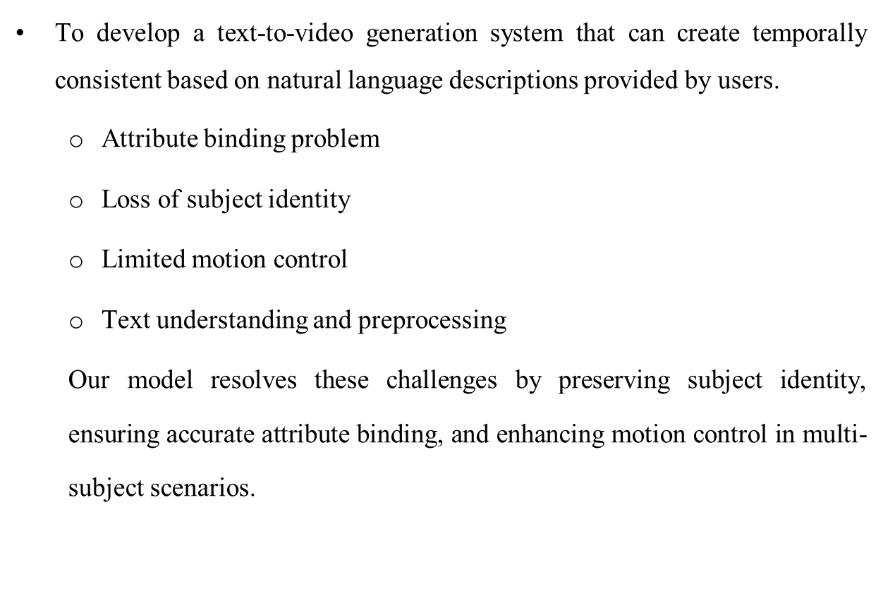
Aim
Department of AI&DS

Slide 3
Abstract
This project proposes an intelligent Text-to-Video generation framework
A GAN-based extractive summarization model is used to convert long text into a short, structured prompt
The summarization module preserves multiple subjects, actions, and context
The optimized prompt is then passed to VideoDreamer, a multi-subject video generation model.
VideoDreamer uses Disen-Mix finetuning and diffusion-based generation.
Department of AI&DS

Slide 4
LITERATURE SURVEY
s.no | Paper Title with Author & Year | Description
1. | VideoDreamer: Customized Multi-Subject Text-to-Video Generation With Disen-Mix Finetuning on Language-Video Foundation Models – Hong Chen, et al.,2025 | Objective: Generate multi-subject text-to-video with subject consistency and motion control. Strength: Introduces Disen-Mix finetuning to preserve multi-subject identity and improve motion consistency. Limitation: High computational cost and depends heavily on prompt quality.
2. | A Generative Adversarial Network-Based Extractive Text Summarization Using Transductive and Reinforcement Learning – Jing Yang, Haoshen Qin, Yiping Sun et al., 2025 | Objective: Improve extractive text summarization using GAN, TLSTM and reinforcement learning. Strength: Reduces greedy sentence selection and improves summary coherence. Limitation: Computationally expensive and complex training process.
3. | AnimateDiff: Animate Your Personalized Text-to-Image Diffusion Models – Yuwei Guo et al., 2023 | Objective: Extend image diffusion model to video generation using motion modules. Strength: Maintains subject identity and smooth motion. Limitation: Motion quality limited for complex scenes.
Department of AI&DS

Slide 5
s.no | Paper Title with Author & Year | Description
4. | Text2Video-Zero: Zero-Shot Text-to-Video Generation – Levon Khachatryan et al., 2023 | Objective: Generate video from text without video training. Strength: Works without additional training data. Limitation: Temporal inconsistency and poor action control.
5. | Make-A-Video: Text-to-Video Generation without Text-Video Data – Meta AI, 2023 | Objective: Generate video from text using image datasets. Strength: No need for paired video-text data. Limitation: Limited motion realism and consistency.
6. | DistilBERT: A Distilled Version of BERT: Smaller, Faster, Cheaper and Lighter – Victor Sanh et al., 2019 | Objective: Develop efficient transformer for NLP tasks. Strength: Faster and lightweight compared to BERT. Limitation: Slight reduction in contextual understanding.

Slide 6
s.no | Paper Title with Author & Year | Description
7. | BERT: Pre-training of Deep Bidirectional Transformers for Language Understanding – Jacob Devlin et al., 2018 | Objective: Improve contextual language representation. Strength: High NLP accuracy and deep semantic understanding. Limitation: Large model size and high computation.
8. | BERTSUM: Pre-training for Extractive Summarization – Yang Liu and Mirella Lapata, 2019 | Objective: Use pretrained BERT for extractive summarization. Strength: High accuracy and contextual understanding. Limitation: Requires high computational resources.
9. | Abstractive Text Summarization using Transformer Models – Liu and Lapata, 2019 | Objective: Generate abstractive summaries using transformer architecture. Strength: Better contextual understanding and semantic representation. Limitation: High computational complexity.
Department of AI&DS

Slide 7
Dataset :
CNN/Daily Mail Dataset
  Widely used for extractive summarization research.
Structure of each sample :
{
article : Full news article (avg 781 words, ~30 sentences)
summary : Human-written highlight summary (avg 56 words,3-5 sentences)
}
Split | Samples
Train | 287,113
Validation | 13,368
Test | 11,490
Total | 311,971
Department of AI&DS

Slide 8
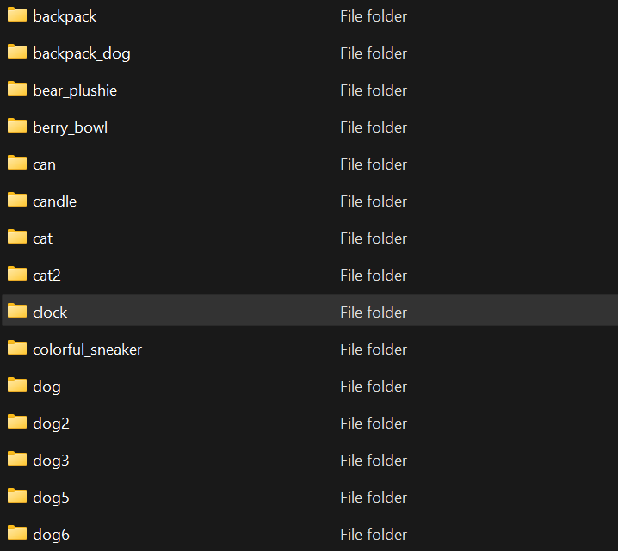


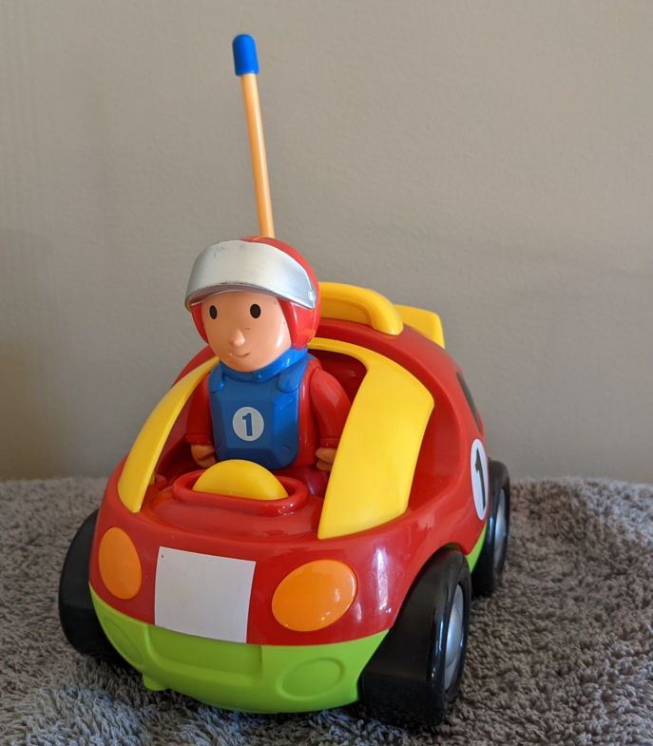

2. DreamBooth Dataset
A collection of subject images designed for personalized text-to-image generation. Each subject folder contains a small number of high-quality reference images representing a specific object, animal, or concept.
Department of AI&DS

Slide 9
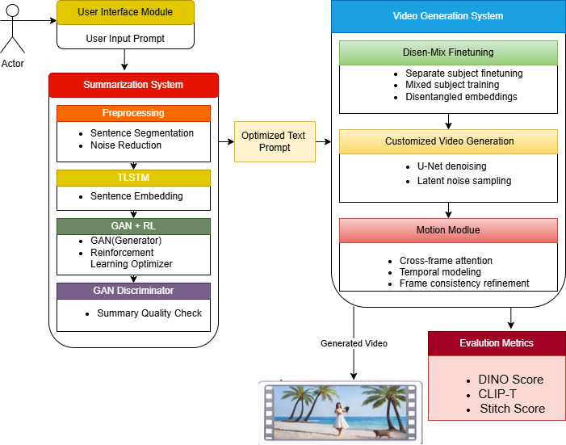
System Architecture for VideoDreamer based Multi-subject Text-Video Generator

Slide 10
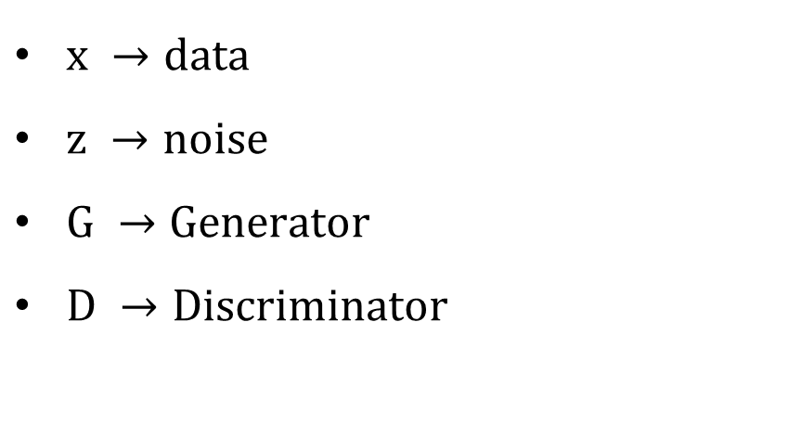
Module Description
1. GAN
Department of AI&DS

Slide 11
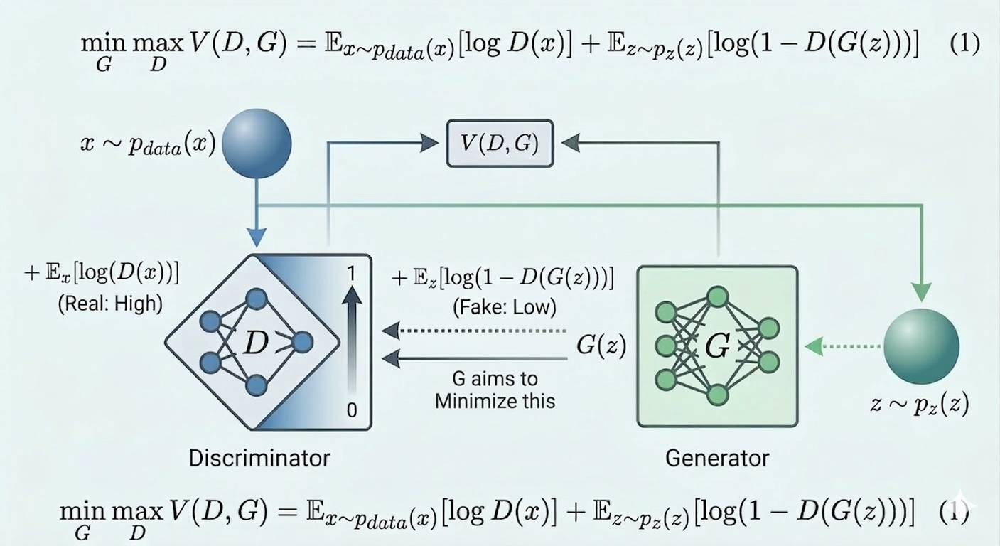
GAN Architecture
Department of AI&DS

Slide 12
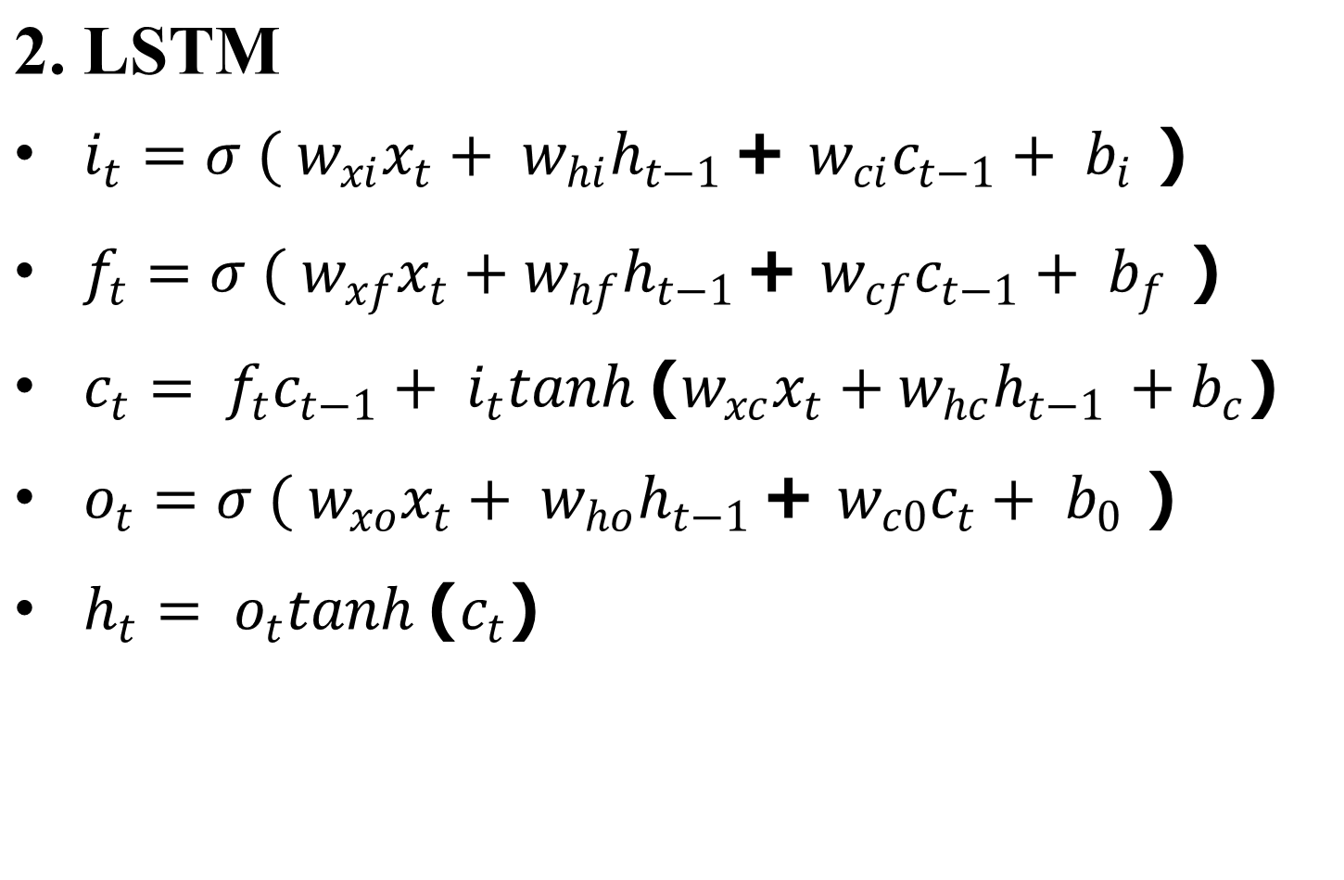
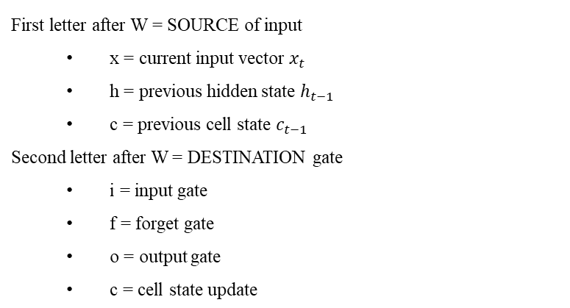
Department of AI&DS

Slide 13
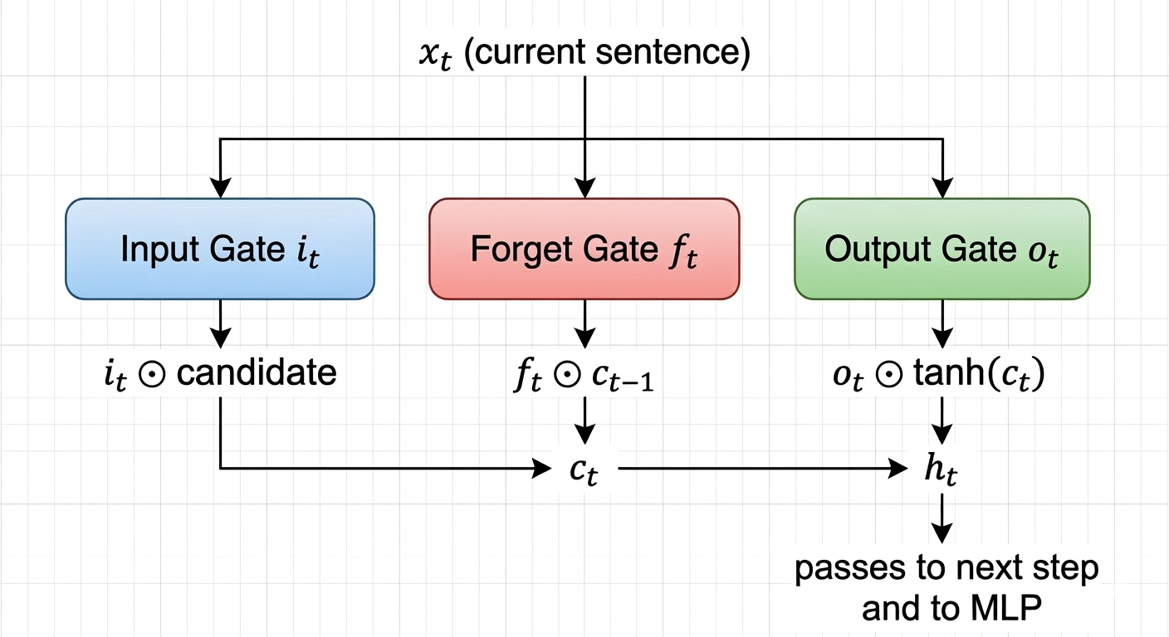
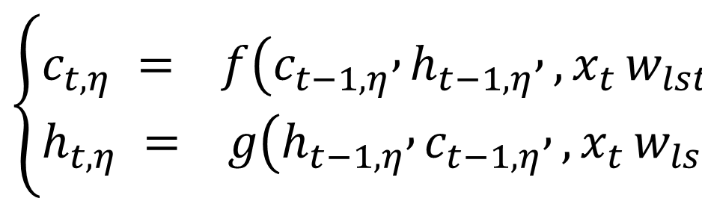
LSTM
Department of AI&DS

Slide 14
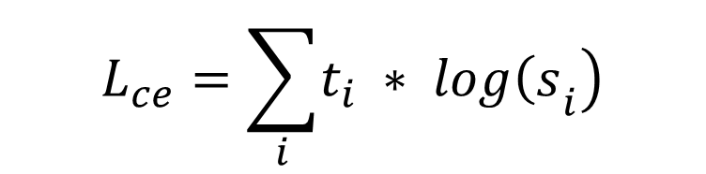
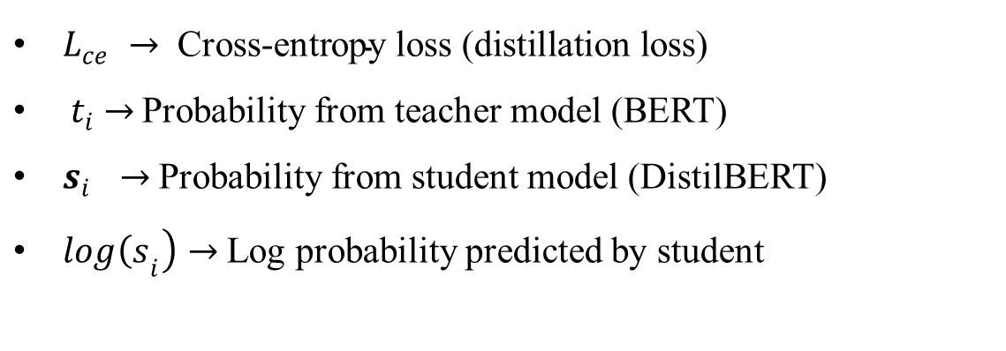
3. Distil-BERT
Department of AI&DS

Slide 15
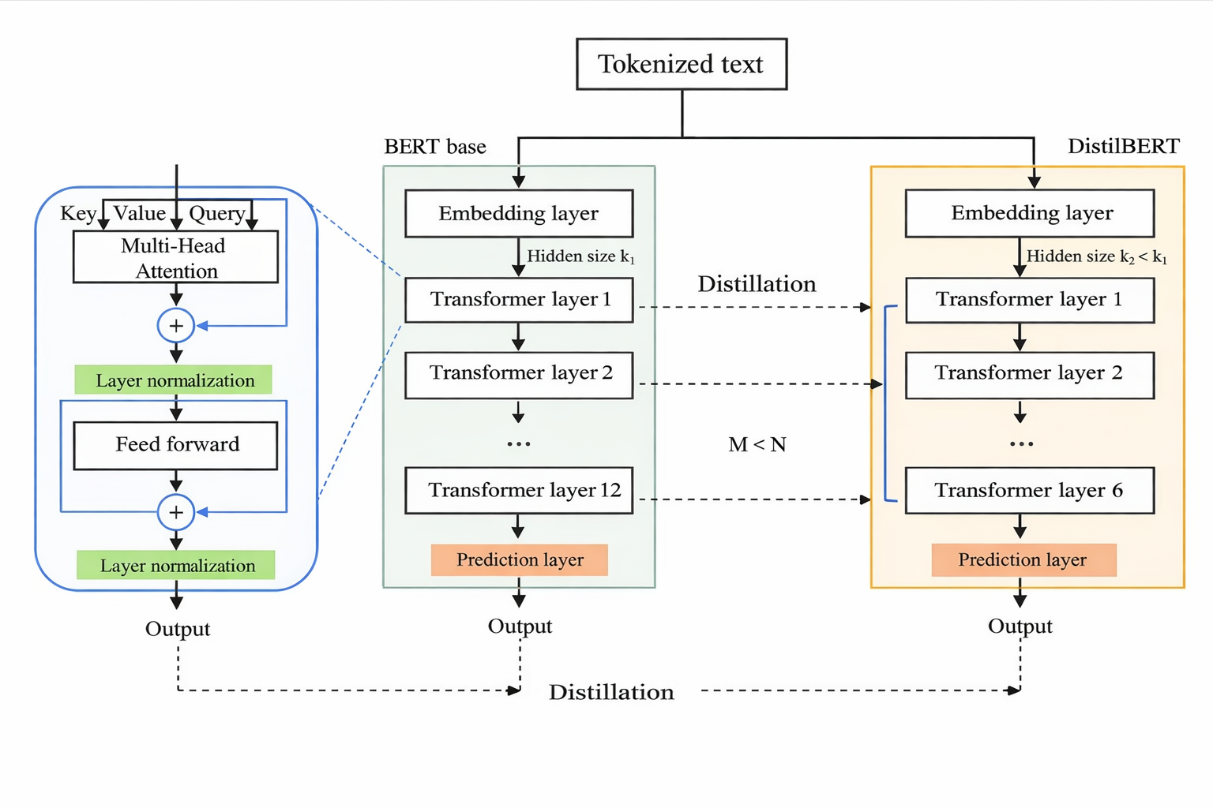
Distil-BERT Architecture
Department of AI&DS

Slide 16
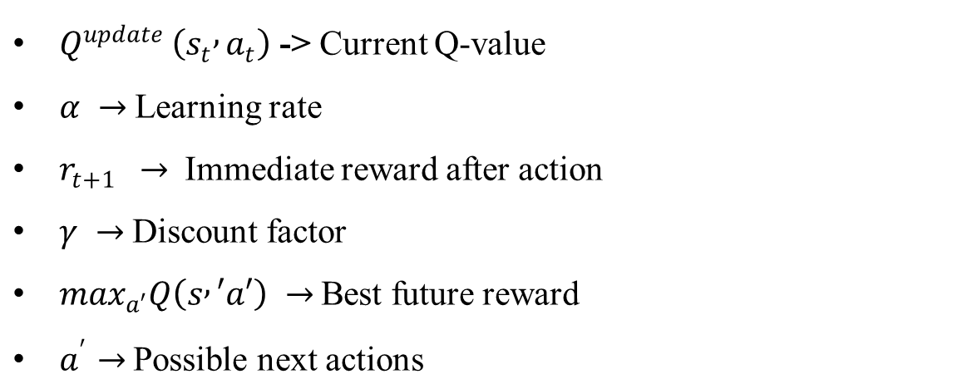
4. Discriminator Reinforcement Learning
Department of AI&DS

Slide 17
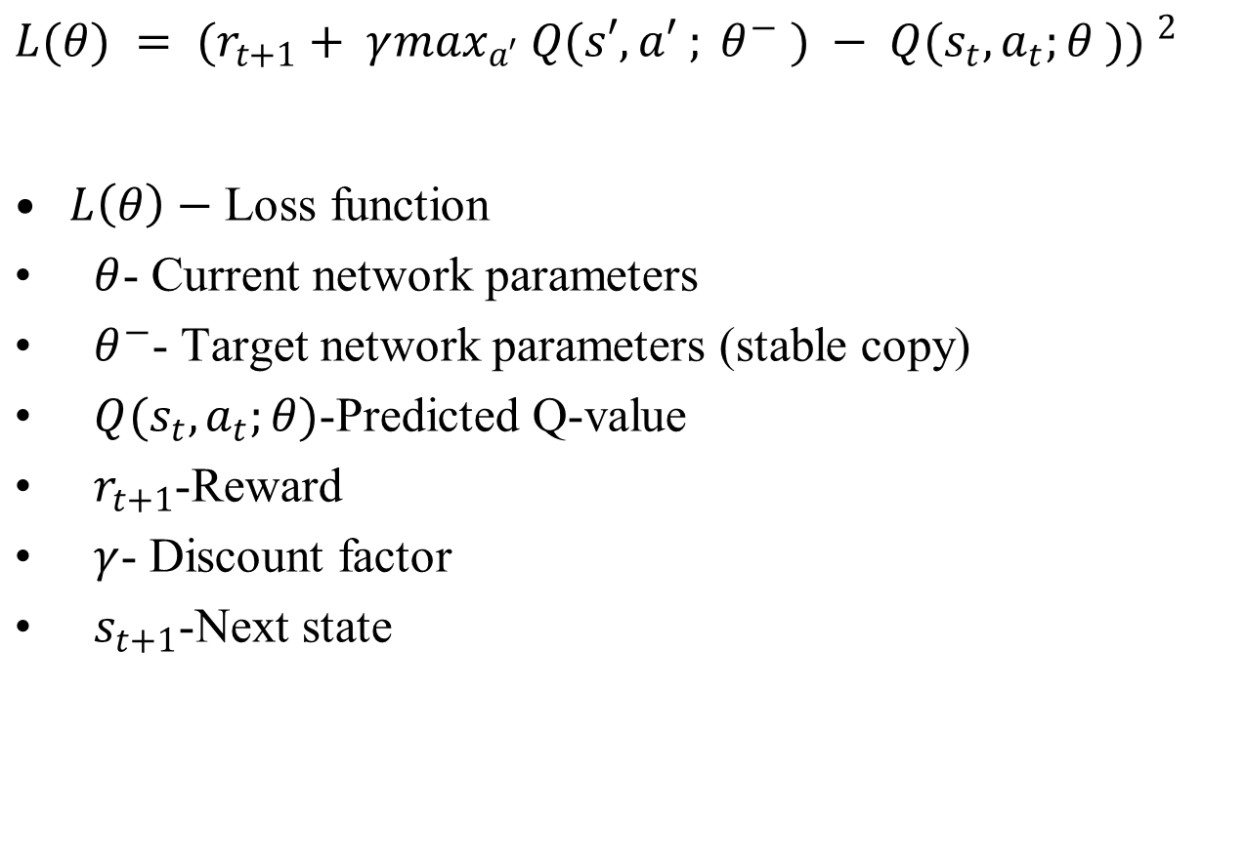
Department of AI&DS

Slide 18
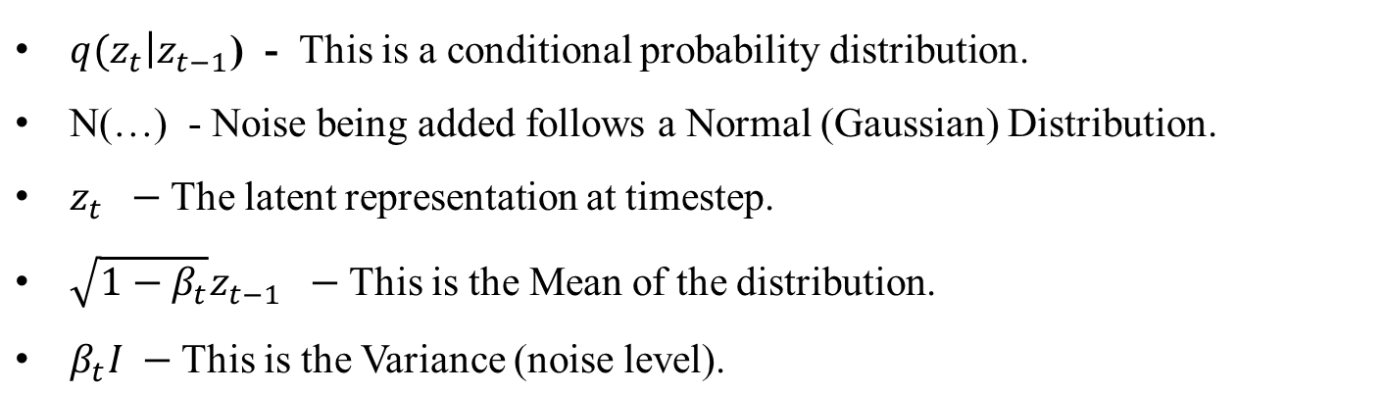
5. Forward Diffusion Process
Department of AI&DS

Slide 19
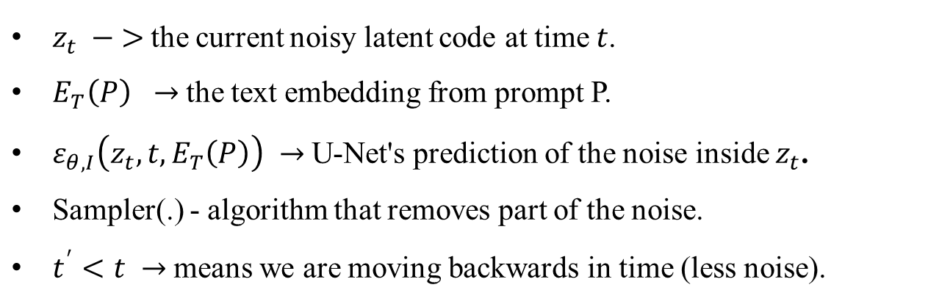
6. Backward Diffusion Process
Department of AI&DS

Slide 20
7. U-Net Training Function
The U-Net learns to match predicted noise with actual noise
Training minimizes the difference between real noise and predicted noise
This enables effective denoising during generation
Department of AI&DS

Slide 21

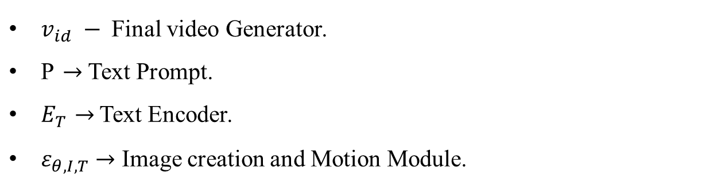
8. Text-Video Function
Department of AI&DS

Slide 22
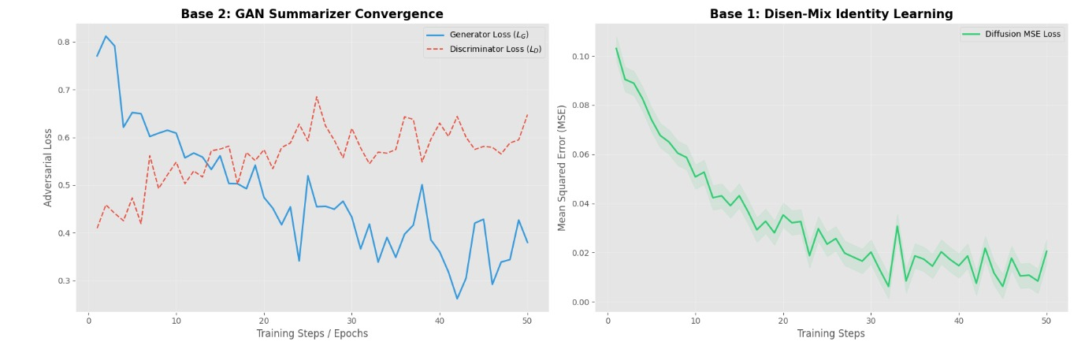
Results
Loss Curve
Department of AI&DS

Slide 23
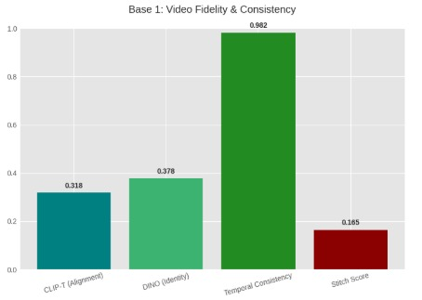
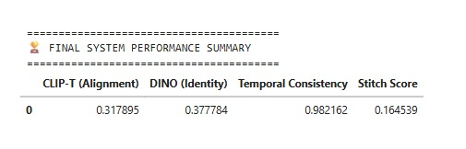
Performance metrics
Department of AI&DS

Slide 24
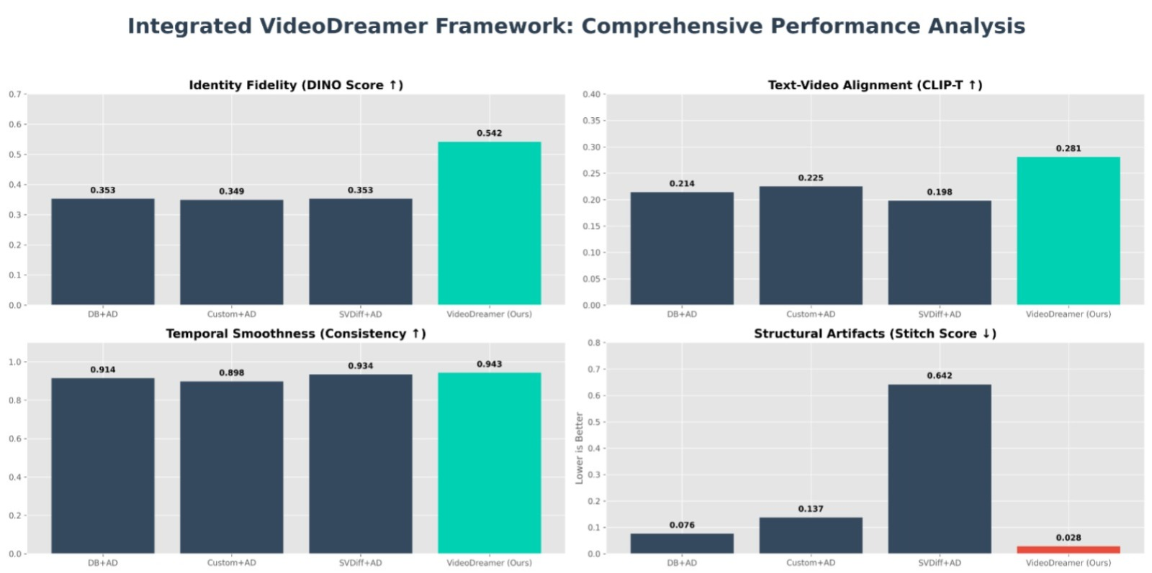
Comparision
Department of AI&DS

Slide 25
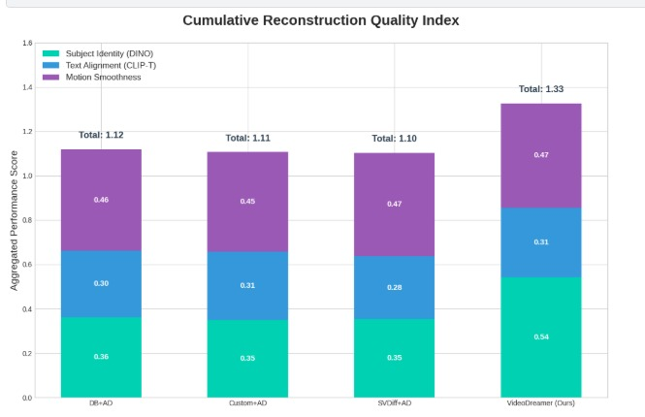
Comparision (cont…)
Department of AI&DS

Slide 26
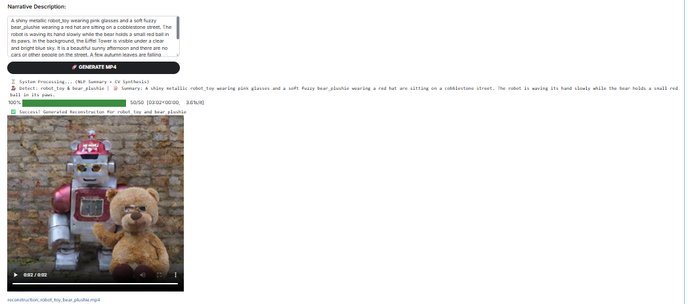
Sample output
Department of AI&DS

Slide 27
Sample output(cont…)
Input : A shiny teapot and a lit candle are sitting on a wooden floor next to an old clock. The teapot is floating slightly mid-air, while the candle is glowing with a flickering orange flame. Through the window, the Eiffel Tower can be seen under a deep blue evening sky. The room is surrounded by a dense jungle visible through the glass. The air is still, and the light from the candle creates highly detailed textures and realistic shadows on the wood.
Output : A shiny teapot and a lit candle are sitting on a wooden floor next to an old clock. Through the window, the Eiffel Tower can be seen under a deep blue evening sky.
Video
Department of AI&DS

Slide 28
Department of AI&DS

Slide 29
Sample output(cont…)
  Output1
  Output2
Department of AI&DS

Slide 30
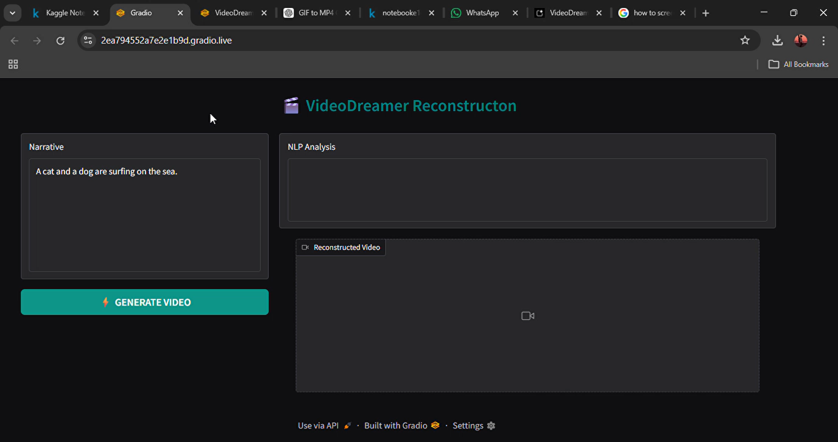
Demo
Department of AI&DS

Slide 31
Ethical Considerations
1. Deepfake & Misuse Risk
  Identity manipulation
  Fake political/social videos
2. Data Privacy
  Consent required for subject images
  Responsible dataset collection
3. Bias & Fairness
  Cultural and gender bias risk
  Need balanced training data
4. Misinformation Risk
  Realistic synthetic content
  Requires watermarking & AI detection
Department of AI&DS

Slide 32
Social Impact
1.Film & Media Industry
Reduces production cost and accelerates multi-character visual content creation.
2.Educational Advancement
Transforms textual knowledge into engaging and dynamic visual learning experiences.
3. Cultural Heritage & Preservation
Digitally preserves and revitalizes historical and cultural narratives through AI-generated visualization.
4. Accessibility & Inclusion
Enables inclusive content creation accessible to diverse users and learning needs.
5.Creative Economy Growth
Empowers creators and businesses with scalable AI-driven multimedia production tools .
Department of AI&DS

Slide 33
References
[1] M.Bain,A.Nagrani, G.Varol, and A. Zisserman, “Frozen in time: A joint video andimageencoderforend-to-endretrieval,” in Proc. IEEE/CVF Int. Conf. Comput. Vis., 2021, pp. 1728–1738.
[2] H. Xue et al., “Advancing high-resolution video-language representation with large-scale video transcriptions,” in Proc. IEEE/CVF Conf. Comput. Vis. Pattern Recognit., 2022, pp. 5036–5045.
[3] W.Hong,M.Ding,W.Zheng,X.Liu,andJ.Tang,“Cogvideo:Large-scale pretrainingfortext-to-videogenerationviatransformers,”inProc.11thInt. Conf. Learn. Representations, 2022, pp. 1–24.
[4] C.Schuhmannetal.,“LAION-5B:An open large-scale dataset for training next generation image-text models,” in Proc. Adv. Neural Inf. Process. Syst., 2022, vol. 35, pp. 25278–25294.
Department of AI&DS

Slide 34
References(Cont..)
[5] U. Singer et al., “Make-a-video: Text-to-video generation without text video data,” in Proc. 11th Int. Conf. Learn. Representations, 2023, pp. 1
[6] A. Joshi, E. Fidalgo, E. Alegre, and L. Fernández-Robles, ‘‘Deep Summ: Exploiting topic models and sequence to sequence networks for extractive text summarization,’’ Expert Syst. Appl., vol. 211, Jan. 2023, Art. no. 118442.
[7] A. Ghadimi and H. Beigy, ‘‘SGCSumm: An extractive multi-document summarization method based on pre-trained language model, submodularity, and graph convolutional neural networks,’’ Expert Syst. Appl., vol. 215,Apr. 2023, Art. no. 119308
Department of AI&DS

Slide 35
References (Cont..)
[8] Y. Ge, S. Jeoung, and J. Diesner, ‘‘Extractive summarization via fine grained semantic tuple extraction,’’ in Proc. 17th Int. Natural Lang. Gener. Conf., 2024, pp. 121–133.
[9] P. Savcı and B. Das, ‘‘Enhancing text summarization: Evaluating transformer-based models and the role of large language models like Chat GPT,’’ in Proc. 4th Int. Informat. Softw. Eng. Conf. (IISEC), Dec. 2023,pp. 1–4.
[10] P. K. Garg, R. Chakraborty, S. Gupta, and S. K. Dandapat, ‘‘IKDSumm: Incorporating key-phrases into BERT for extractive disaster tweet summarization,’’ Comput. Speech Lang., vol. 87, Aug. 2024, Art. no. 101649.
Department of AI&DS

Slide 36
Thank You…
Department of AI&DS

